Slide 1
GRANITE STATE RAILROAD (GSRR)
INFORMATION SYSTEM DESIGN AND ANALYSIS
Course: IST 654 Information Systems Analysis Spring 2020
Client: Ping Zhang

Slide 2




Team Members
Vedika Shenoy
Shwet Jain
Shuying Zhao
Yanqi Yao

Slide 3
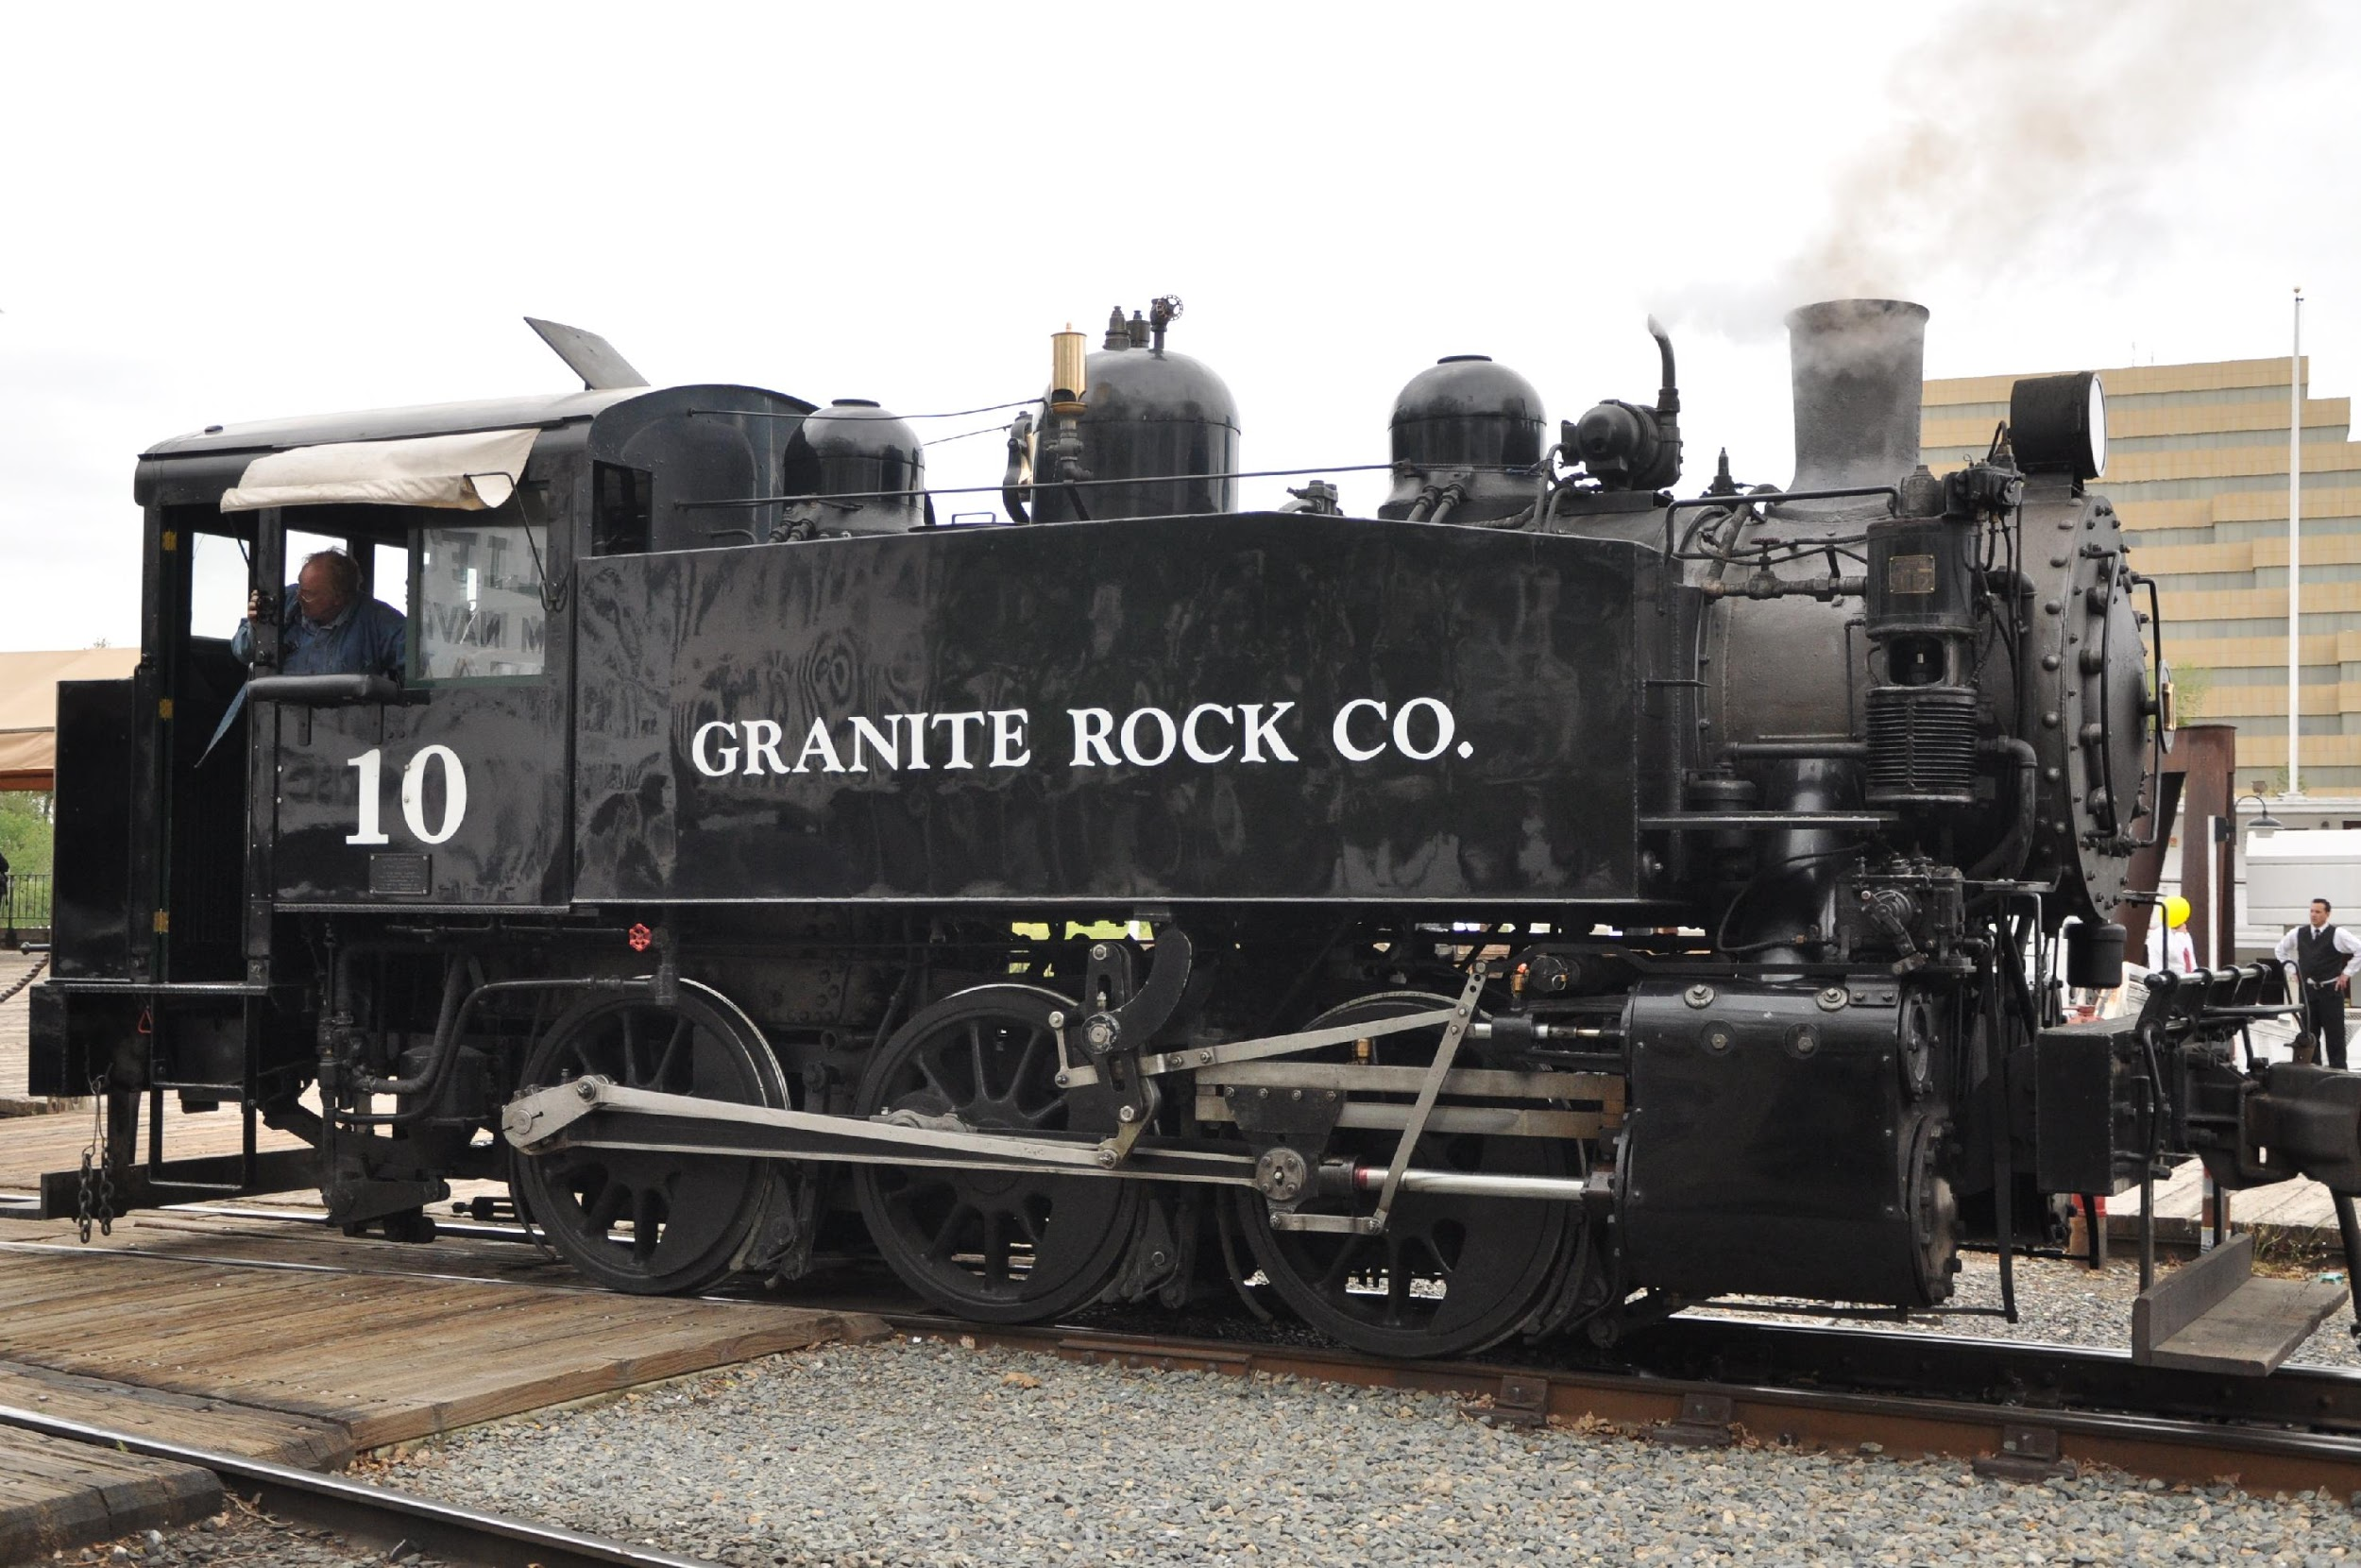
BUSINESS BACKGROUND
Granite State Railroad (GSRR) is an independently owned and operated New Hampshire company that was founded, has operated and continues to expand without any state or federal funds or bank mortgages.
The GSRR is working with the Boston and Maine (B&M) Railroad and the Vermont Railroad (VTR) and running the interface with these companies to exchange freight cars on the daily operation.
Meeting timely requirements of customer service requests, scheduling activities with minimal delay, and billing for the service used are key functionalities of GSSR.
All the activities carried out within the system are form-based and paper-based.

Slide 4

CLIENT’S NEEDS
The current system is paper based and has been established by trial and error method over the years.
Majority of the functional processes involved in the system require manual filling out forms right from handling customer requests to tracking, scheduling of the cars and trains and billing.
Coming up with an information system that can reduce these errors and improve efficiency would be an ideal way to remove dependencies on a manual-based system.

Slide 5
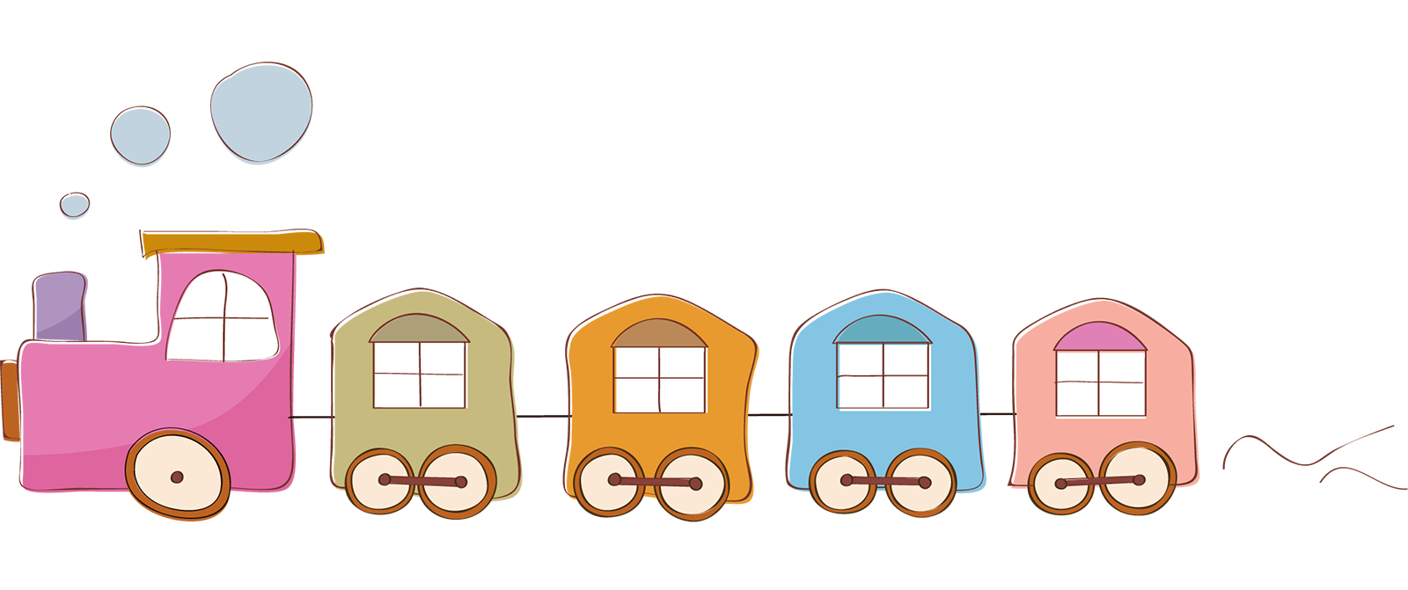
SCOPE
The GSRR would interface with the Boston & Maine Railroad, and Vermont Railroad’s existing systems and focus on automating the tracking, billing and scheduling of the cars and trains to make sure the delivery and efficiently handle the customer requests.
The features of the information system include being able to process the customer requests, reserve trains, train assembly management, view availability and location of trains and cars and to view and edit the scheduled train and car services.

Slide 6
FUNCTIONAL REQUIREMENTS
The system must be able to process customer requests for car delivery
The system must allow the employee to check the car inventory in GSSR and communicate with B&M and VTR for resources
The system must allow the employee to schedule train with cars and locomotive information
The system must be able to generate bills for different services after delivering the service to the customer.

Slide 7
NON- FUNCTIONAL REQUIREMENTS
The system must have an interactive and easy to use online interface.
There must be support for multiple types of users for the system.
The system should be secure and will be accessed by authorized users only.
The system should be accessible to the users at all times of the day.
The system should have high performance which remains constant regardless of the workload.

Slide 8
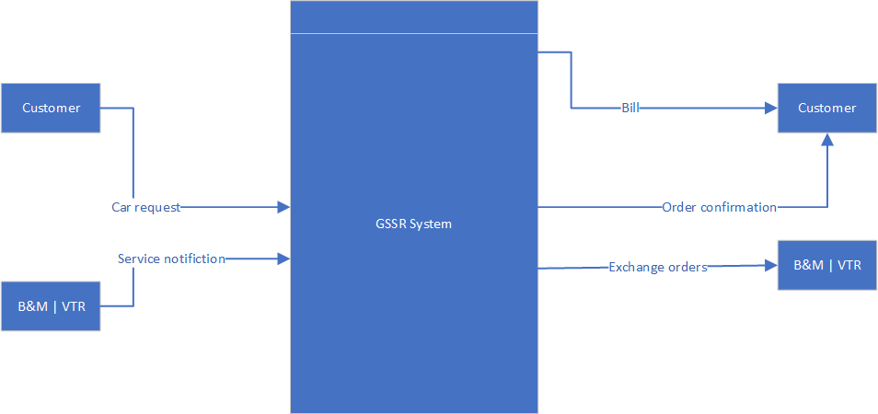
DFD - CONTEXT LEVEL

Slide 9
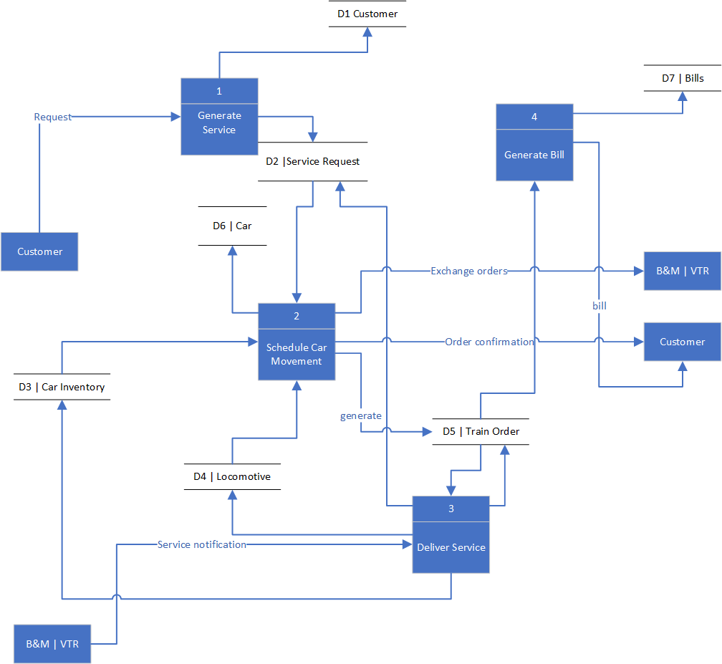
DFD - LEVEL 0

Slide 10
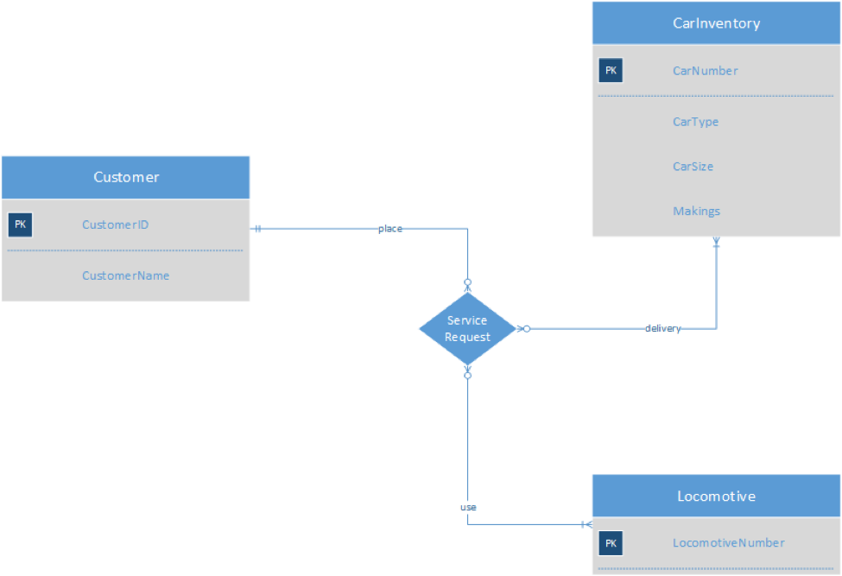
ERD - BASIC ER DIAGRAM

Slide 11
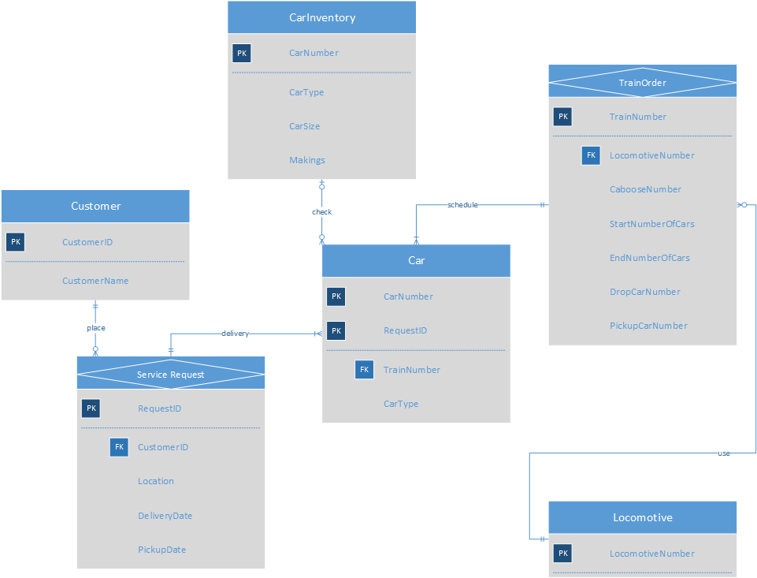
ERD - EXTENDED ER DIAGRAM
Business Assumption:
Each train has one locomotive

Slide 12
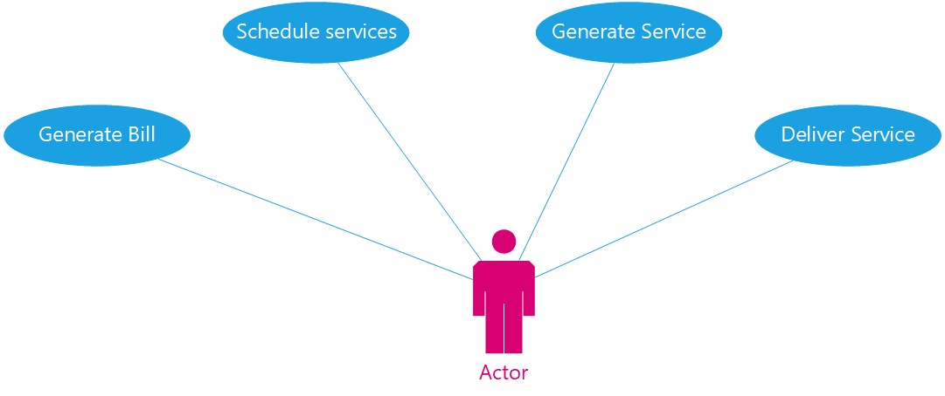
OOA - USE CASE DIAGRAM

Slide 13
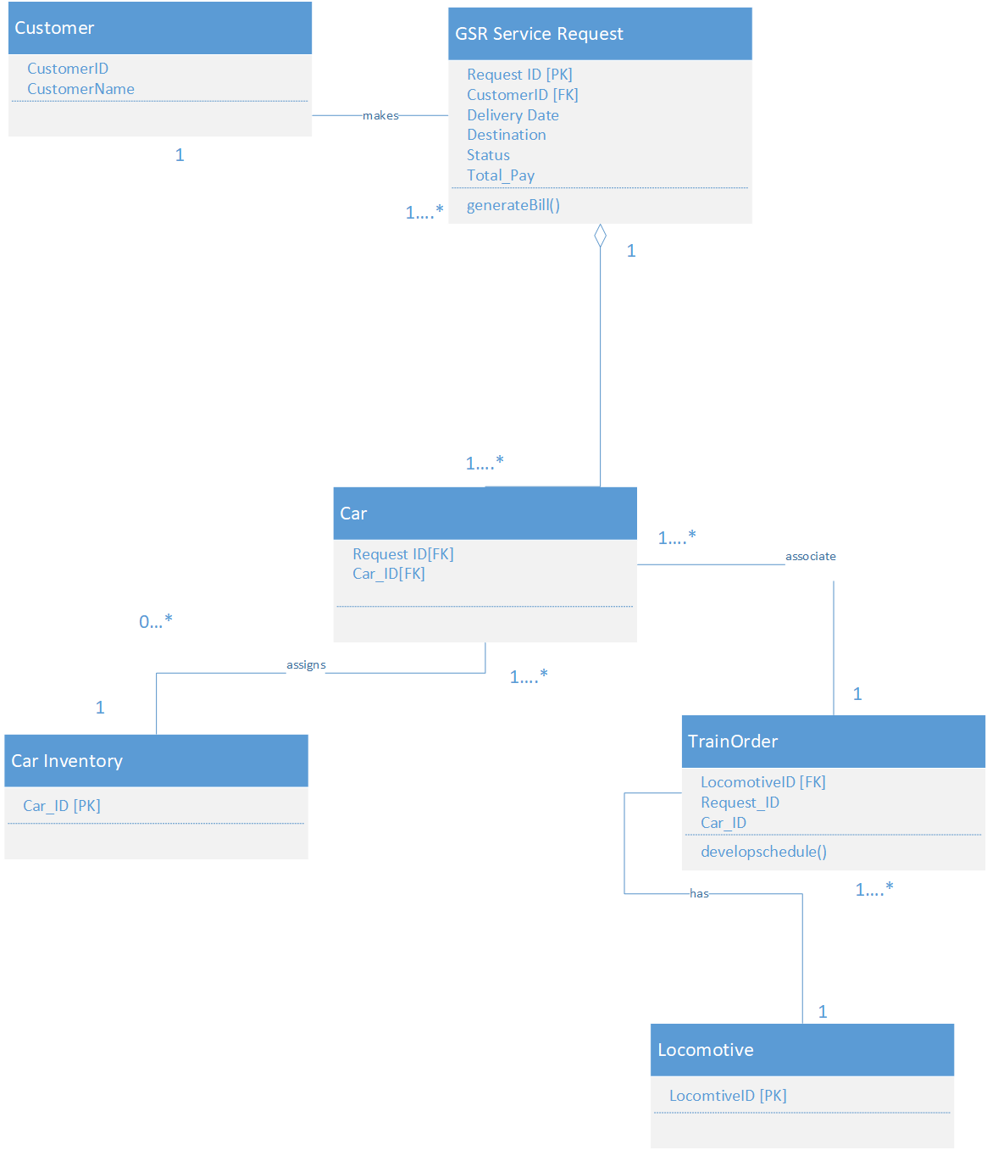
OOA - CLASS DIAGRAM

Slide 14
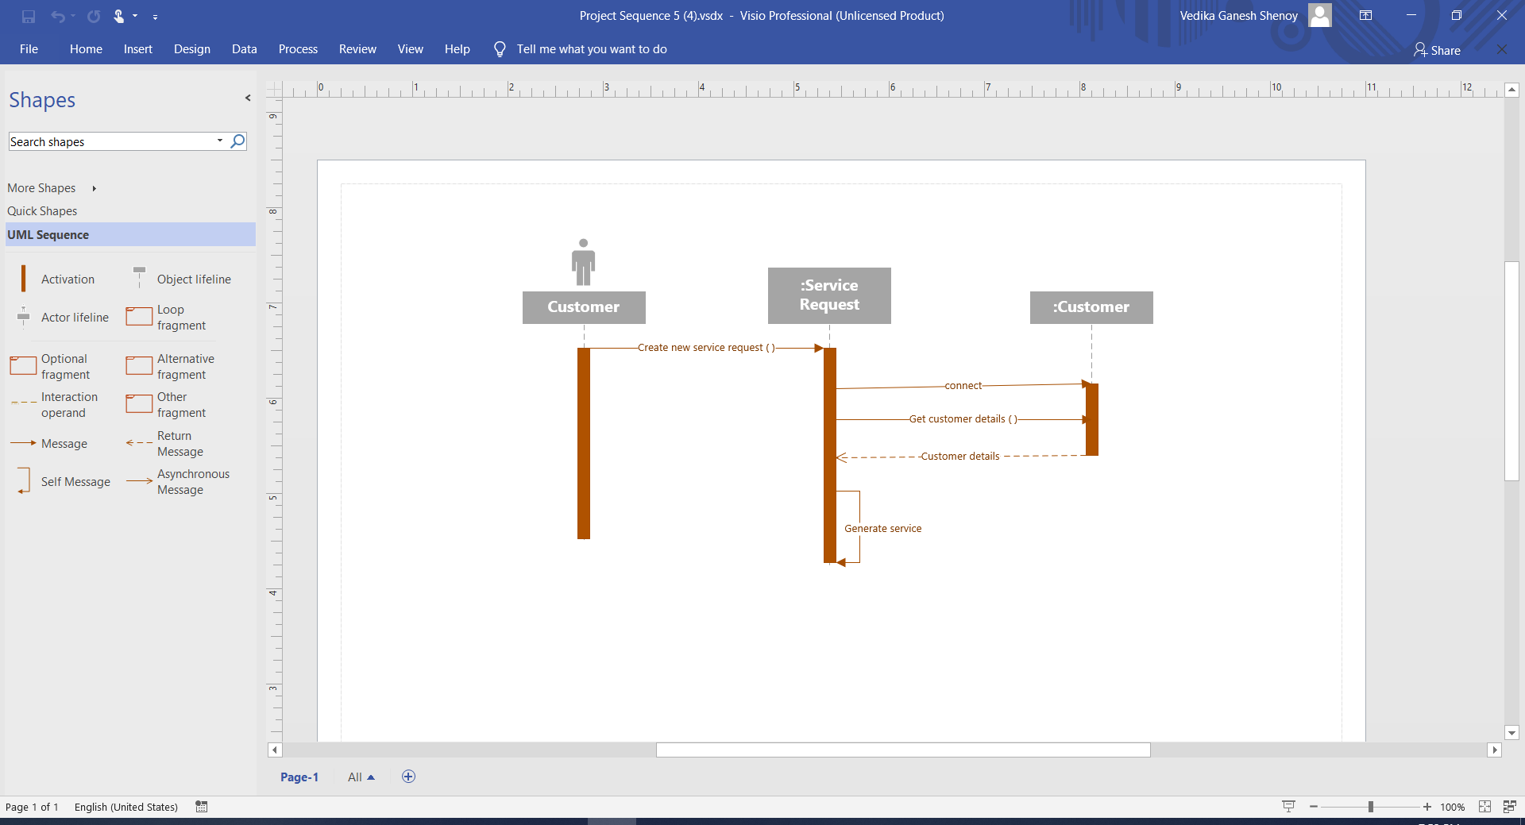
OOA - SEQUENCE DIAGRAM
Generate Service

Slide 15
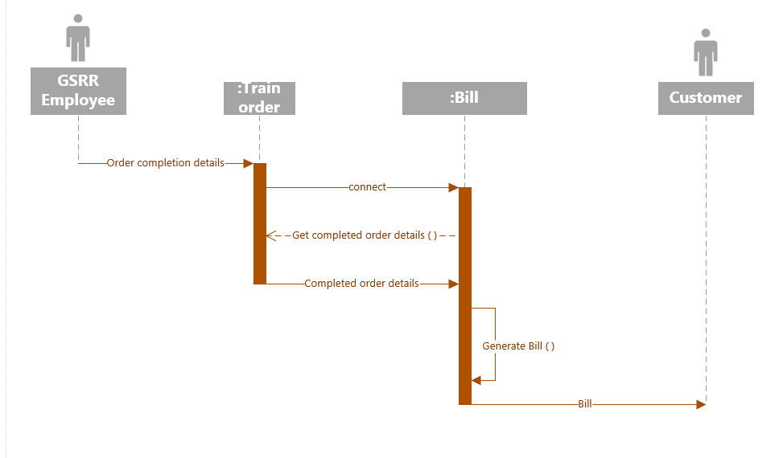
OOA - SEQUENCE DIAGRAM
2. Generate Bill

Slide 16
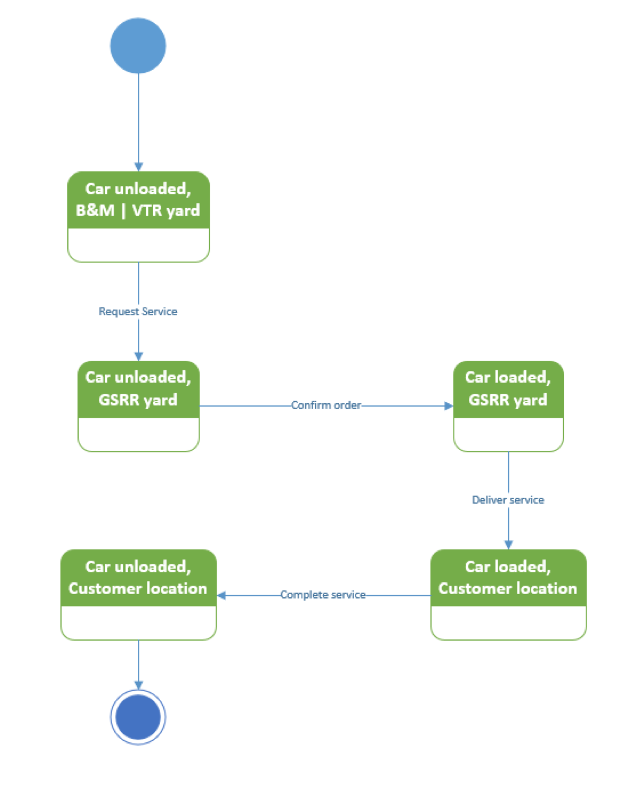
OOA - STATE TRANSITION DIAGRAM
State Transition Diagram for Car

Slide 17
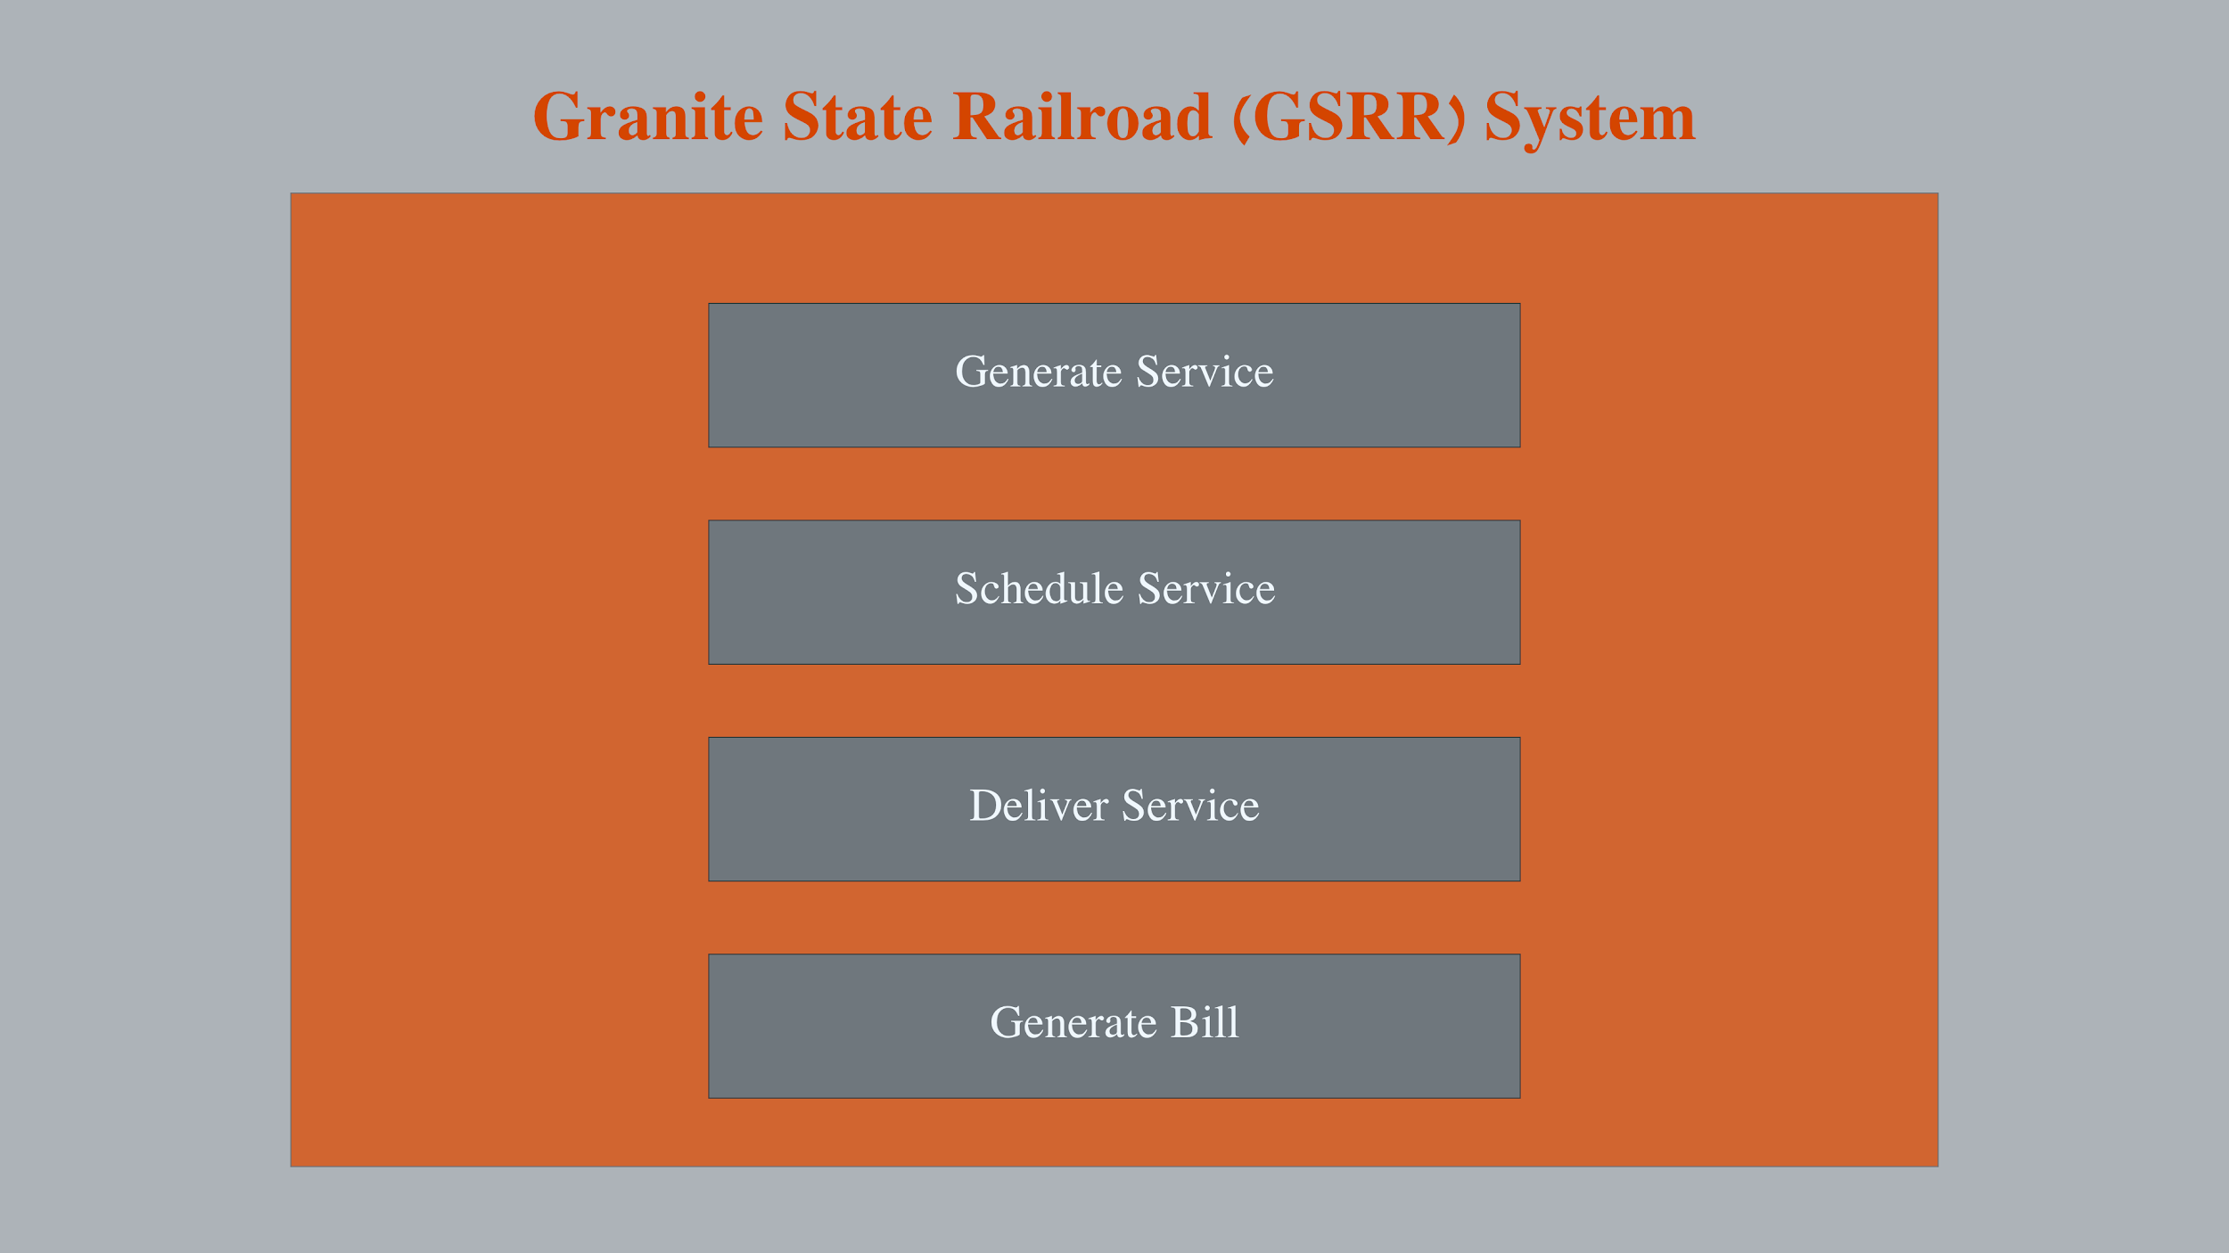
USER INTERFACE
Main screen: display the main functions of the information system

Slide 18
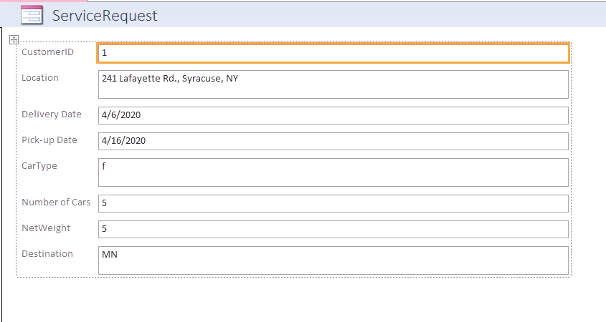
FORMS
Input form - Service Request: Customers send the request into the information system

Slide 19
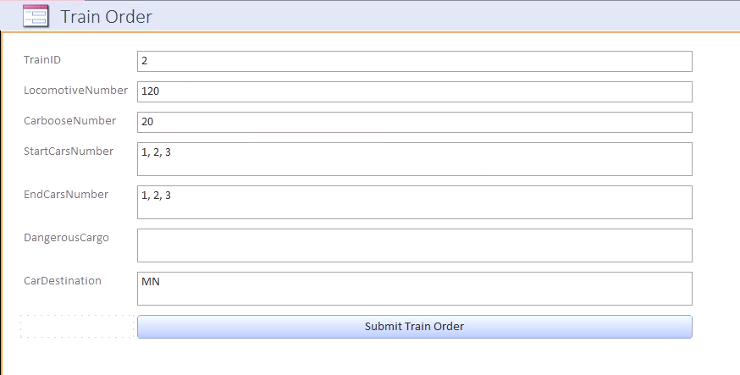
FORMS
Input form - Train Order: train engineer scheduled the service

Slide 20
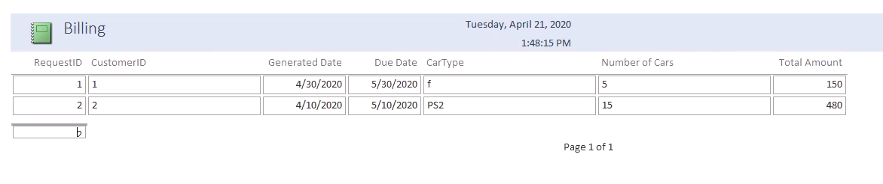
REPORT
Output Report - Bill
The billing report is created for sending to the customers to pay for the services.

Slide 21
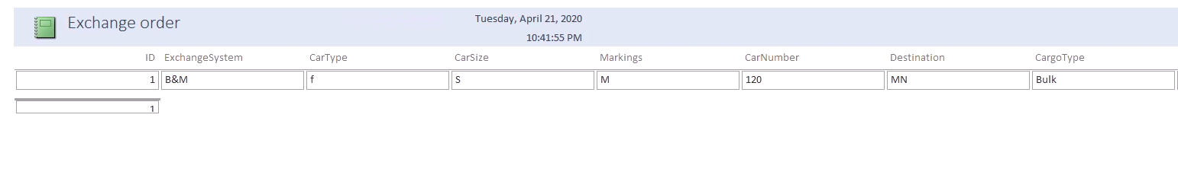
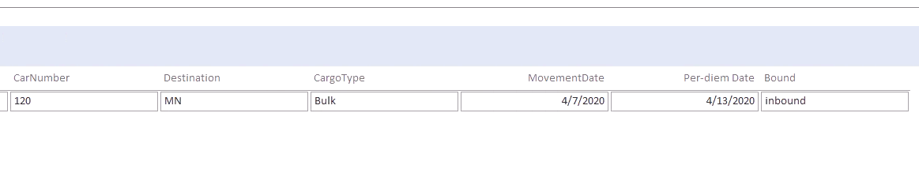
REPORT
Output Report- Exchange order

Slide 22
LESSONS LEARNED
Clear and concise understanding about the company and its business model in the initial stage
Gathering enough information and requirements would be quite important for the further analysis and design
Frequently communication with the client would be quite useful
All the diagrams of the information system should telling the same story
If you see the entire system as a whole, it might seem difficult but as soon as you start with DFD and ERD you will slowly and steadily find your way out.
.

Slide 23
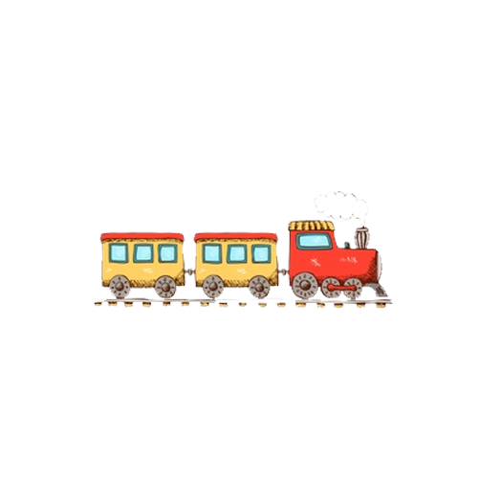
THANKS!
ANY QUESTION?

